Slide 1

HTML semantic tags
In this presentation we will learn about some semantic tags

Slide 2

In HTML some semantic elements are used to define different parts web page we will learn about that.
1.Nav: It specifies a container for navigation links. example:
<nav>
<ul>
<li><a href="#">HTML</a></li>
<li><a href="#">CSS</a></li>
</ul></nav>

Slide 3
2.Header: It represents a section in a document.
<header>This is a header</header>
3.Article : It specifies an independent self-containing article.
<article class= "famous sports">
<h1> football is most popular sport</h1>
</article>

Slide 4
4. Section: It represents a section in a document.
<section>
<h1>footballers</h1>
<p>Lionel Messi is the best footballer in the world</p>
</section>

Slide 5
5.Footer: It specifies a footer for a section or for a document
<footer>
<p>Author: Mr. James Shelby</p>
</footer>
6.Aside:It specifies a tag for content aside from main content (like a sidebar).
<aside>
<p> Delhi is the capital of India.</p>
</aside>

Slide 6
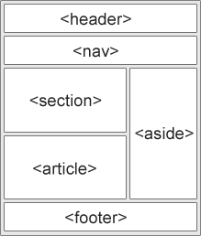
EXPLAINATION:

Slide 7
Some other semantic tags:
7. Details: Defines additional details that the user can view or hide.
8. Summary: Defines a visible heading for a <details> element example:
<details>
<summary>Wrestling</summary>
<p>Wrestling is the sport of fighting.</p>
</details>
9. Mark: This tag defines text that should be marked or highlighted
Example:
<p>Do not forget to watch <mark>news</mark>today</p>

